Slide 1
RELISH - SIMULATION OF CULINARY HYBRID APP DEVELOPMENT
PRESENTED BY :
G.DEEPTHA
T.SOWMYAA
M.S.SRINIDHI

Slide 2
HYBRID APPLICATIONS
WEB TECHNOLOGIES : HTML, CSS, and Java Script
Hybrid apps are hosted inside a native application that utilizes a mobile platform’s WebView.
Single source code is deployable in all platform.

Slide 3
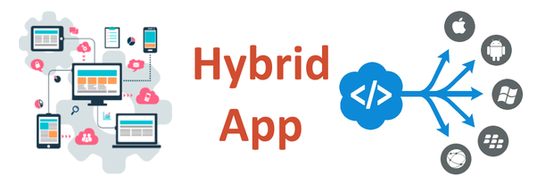

Slide 4
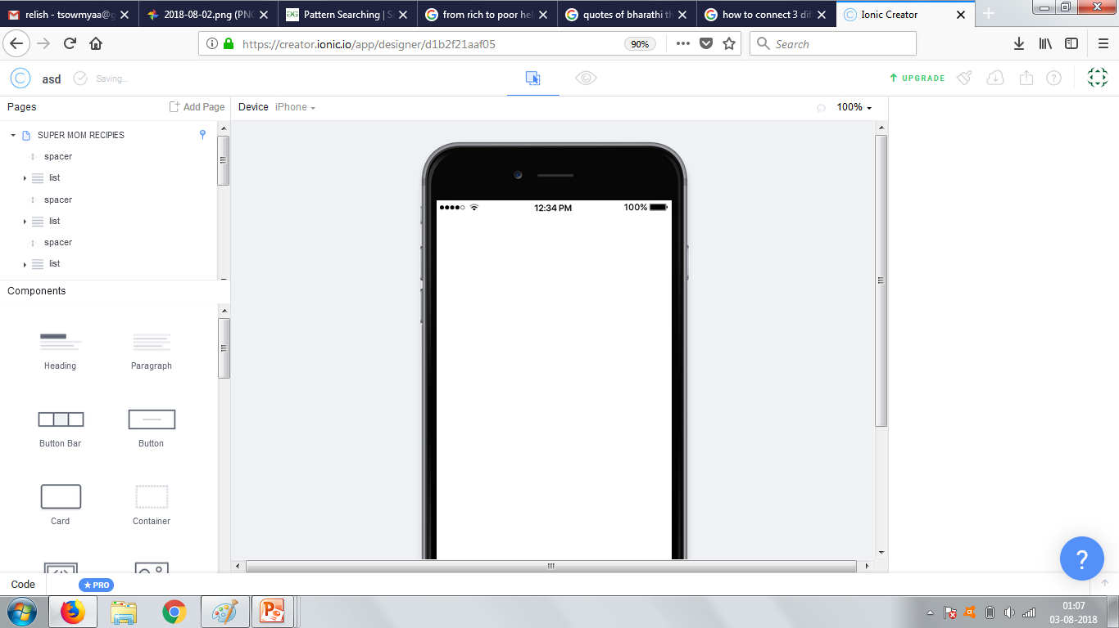
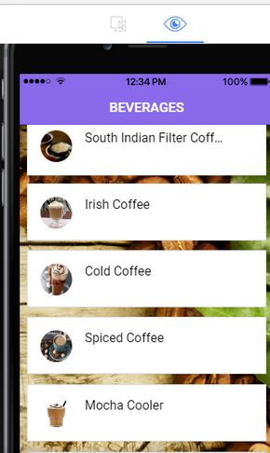
RELISH
Our hybrid application simulation is Relish
It includes recipe in all cadre

Slide 5
Special features
Recipes on every category - starting from beverages to dessert
Quick recipes – delicious recipes with minimal ingredients
Seasonal recipes – recipes for a particular season
Grandma recipes- authentic indian recipes

Slide 6
Additional features
Provides personalized selection method
User has access to vegan, vegetarian, non – vegetarian and barberque
recipes in all categories
Cooking hacks are best cooking tips available for both beginners and enthusiast

